Slide 1
Lecture 7

Slide 2
What is Design?

Slide 3
System Design
Use the class structure produced in the analysis stage to design a system that behaves in the manner specified by the model.

Slide 4
Issues
Platform
Language
User Interfaces
Classes and Interfaces
Long-term Storage
Failures
System Type (Centralized or Distributed)
Protection

Slide 5
A Major Design Strategy
Separate the User Interface and the Business Logic

Slide 6
Major Activities
Come up with a set of classes.
Assign responsibilities to the classes and determine the necessary data structures and methods.
Iterative

Slide 7
The Physical Classes

Slide 8
Starting Point
Conceptual Classes
Member
Book
Library
Borrows
Hold
Relationships Between
Library and Member
Library and Book

Slide 9
Adding Members and
Books

Slide 10
Registering a Member
UI should accept the details of the member.
Where should the member object be created?
UI?
Library?
MemberList?

Slide 11
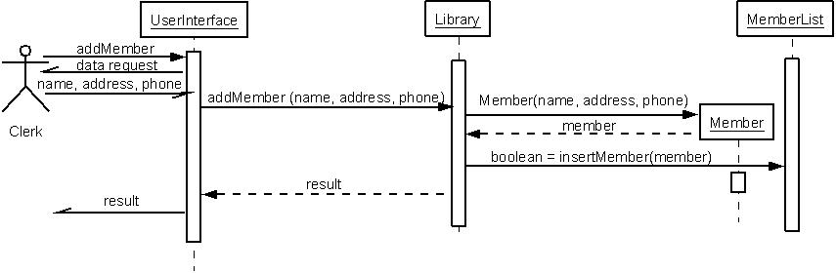
Sequence Diagram for Adding a Member

Slide 12
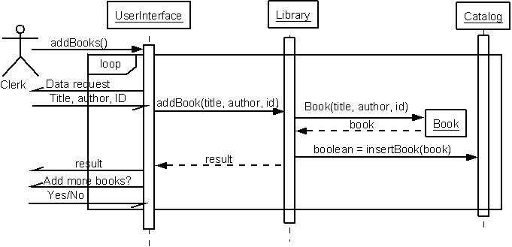
Adding Books

Slide 13
Issuing, Returning, and Returning
Books

Slide 14
Issuing Books
Search for Member:
Option 1:
Get an enumeration of all Member objects from MemberList.
Get the ID from each and compare with the target ID.
Option 2:
Delegate the entire responsibility to MemberList.

Slide 15
Issuing Books
Issuing process:
Business logic should not be moved to UI
Member should not be responsible for the issue
logic
Generation of Due Date:
Done in Book. Why?

Slide 16
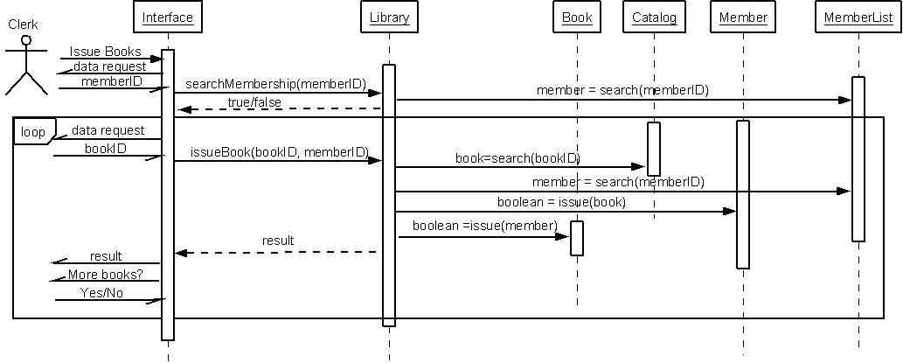
Issuing Books

Slide 17
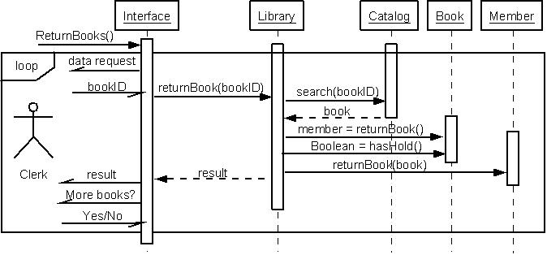
Returning Books

Slide 18
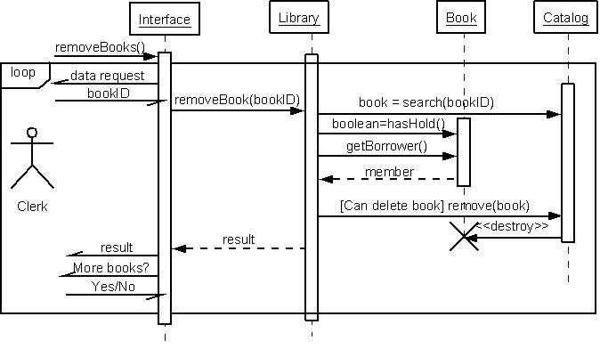
Removing Books

Slide 19
Transactions

Slide 20
Member Transactions
Member class stores information about the transactions.
Need a class Transaction
type: issue, return, place or remove hold,
date
title of the book
UI decides the format to display
getTransactions returns Transaction objects to UI via Library

Slide 21
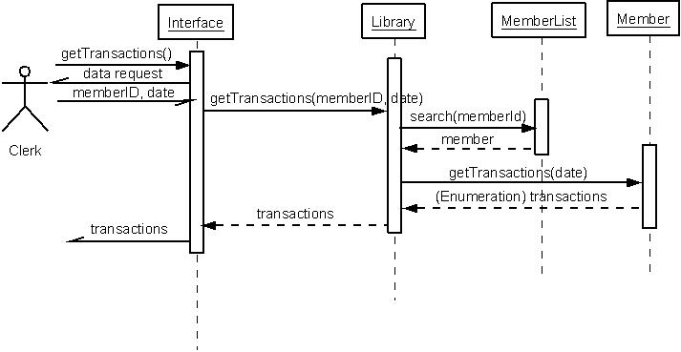
Displaying Transactions

Slide 22
Managing Holds

Slide 23
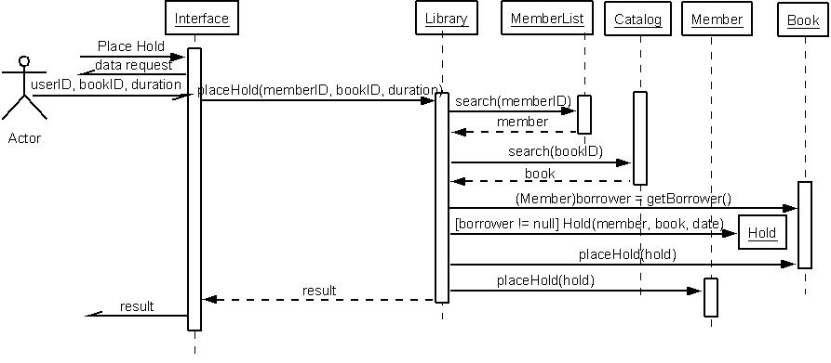
Placing a Hold

Slide 24
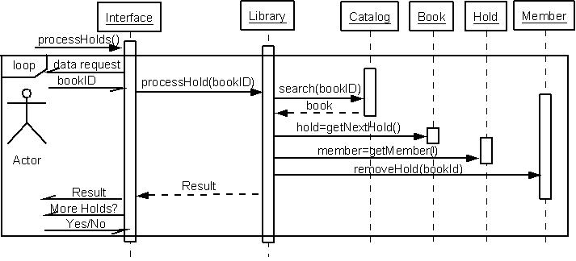
Processing Holds

Slide 25
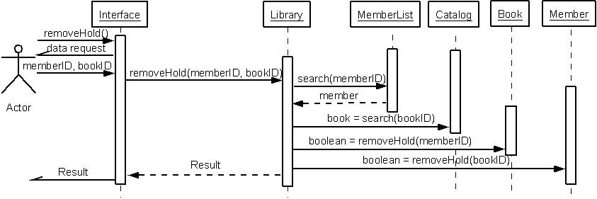
Removing Holds

Slide 26
Removing Books

Slide 27
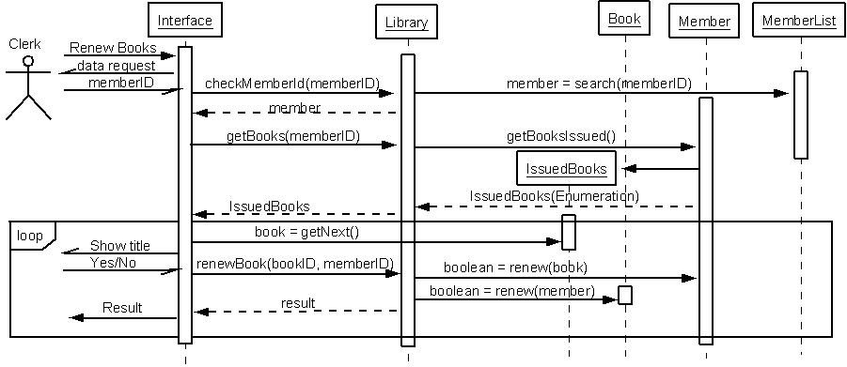
Renewing Books

Slide 28
Class Diagrams

Slide 29
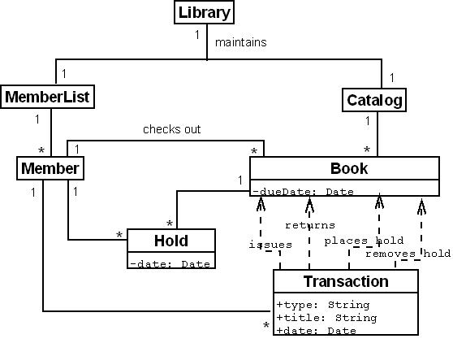
Software Classes

Slide 30
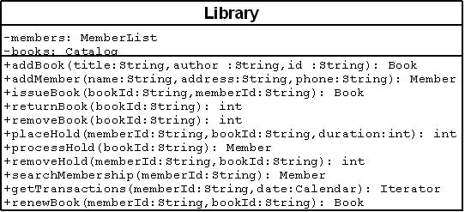
Class Diagram: Library

Slide 31
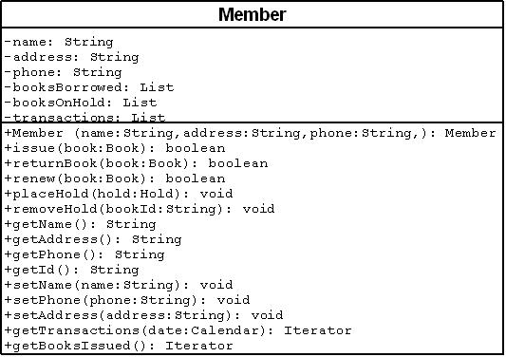
Class Diagrams: Member

Slide 32
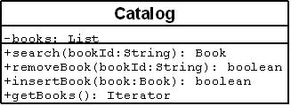
Class Diagram: Catalog

Slide 33
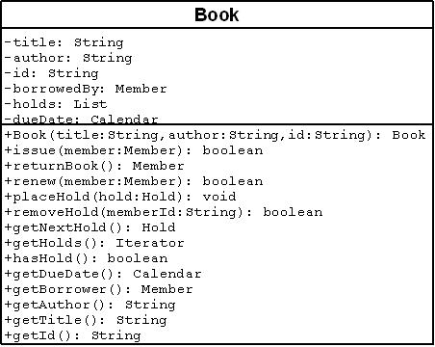
Class Diagrams: Book

Slide 34
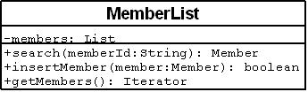
Class Diagram: MemberList

Slide 35
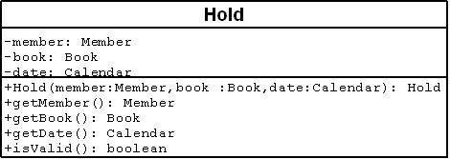
Class Diagrams: Hold

Slide 36
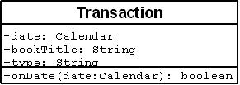
Class Diagrams: Transaction

